Slide 1

Electrical Machinery Fundamentals
EE 250 SPRING 2020
Lecture 9-Chapter 17
1

Slide 2
Chapter 17 Synchronous Motor

Slide 3
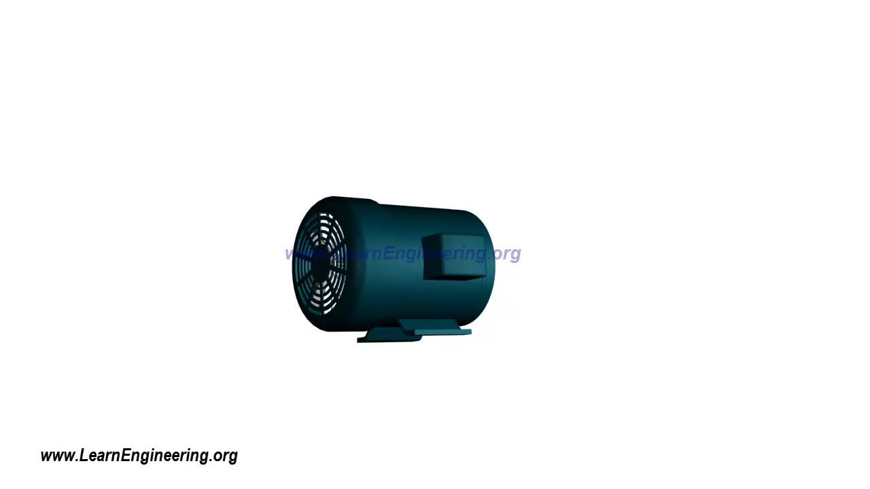

Slide 4
17.1 Construction
Stator:
Identical to salient-pole generators
Slotted magnetic core with 3-phase lap winding => Winding resembles to 3-phase induction motor
Rotor:
Salient poles that are excited by DC current
Excited coils are connected in series to two slip-rings and DC current is fed into winding from an external exciter
Slots are also punched out along the circumference of the salient poles
Caries squirrel-cage winding similar to 3-phase induction motor called damper winding and serves to start the motor
Working:
Small 3-phase generator (exciter) and 3-phase rectifier are mounted on shaft
I_{X} feeding to salient-pole windings without going through slip-rings and brushes
Current can be controlled by controlling I_{C}
n_{s}=120*(f/p)
Benefits:
Constant speed (achieved by interacting constant and rotating magnetic field) irrespective of the load

Slide 5
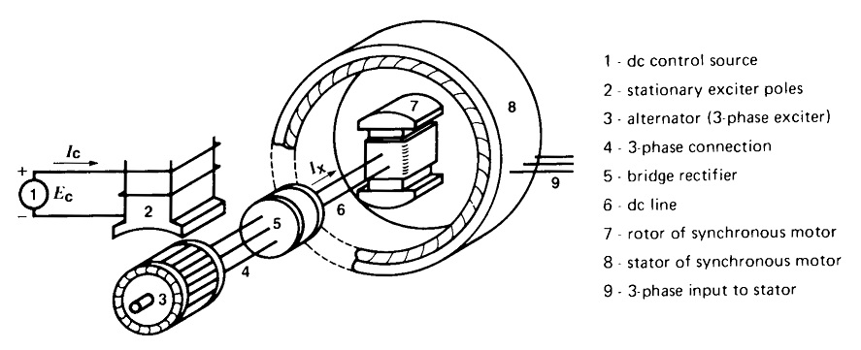
17.1 Construction

Slide 6
17.2 Starting a synchronous motor
Can not start by itself and requires initial push, mostly by squirrel-cage assembly and starts just like induction motor
3-phase supply to stator => Motor accelerates until reaches speed slightly below synchronous speed => DC excitation is suppressed during starting period
Rotating flux created by stator sweeps across the slowly moving salient poles of rotor
As large number of turns are present on rotor => High voltage is induced in rotor windings when it turns at low speed
Voltage appears across slip rings and decreases as rotor speeds up and becomes negligible when rotor approaches synchronous speed
To limit the voltage and to improve the starting torque, we either short-circuit the slip rings or connect them to auxiliary resistor during the starting period
In case of limited capacity of supply line, we sometime have to apply reduced voltage to stator
Large synchronous motors are sometimes brought up to speed by an auxiliary motor known as pony motor

Slide 7
17.3 Pull-in torque
When rotor speed reaches near to synchronous speed then rotor is excited with DC current => Produces alternate N and S poles around the circumference of rotor
If at this instant rotor poles faces opposite poles that are on stator then strong magnetic attraction takes place and rotor gets locked with stator, and rotor is literally yanked into step with revolving field
Torque developed at the moment described above is called pull-in torque
Pull-in torque of synchronous motor is powerful, but the DC current must be applied at the right time
Mechanical shock if DC current is not applied at the right time that will bring N pole of stator in front of N pole of rotor and similar case for S pole => Motor will slow down => Circuit breaker will trip
Starter designing for detection of precise moment that will help in applying DC current at right time => Results in smooth running of synchronous motor
When motor turns at synchronous speed, then no voltage induction in squirrel-cage , so , it carries no current => Behavior of synchronous is entirely different from that of induction motor
Direction reversal: Simply interchange any two lines connected to the stator

Slide 8
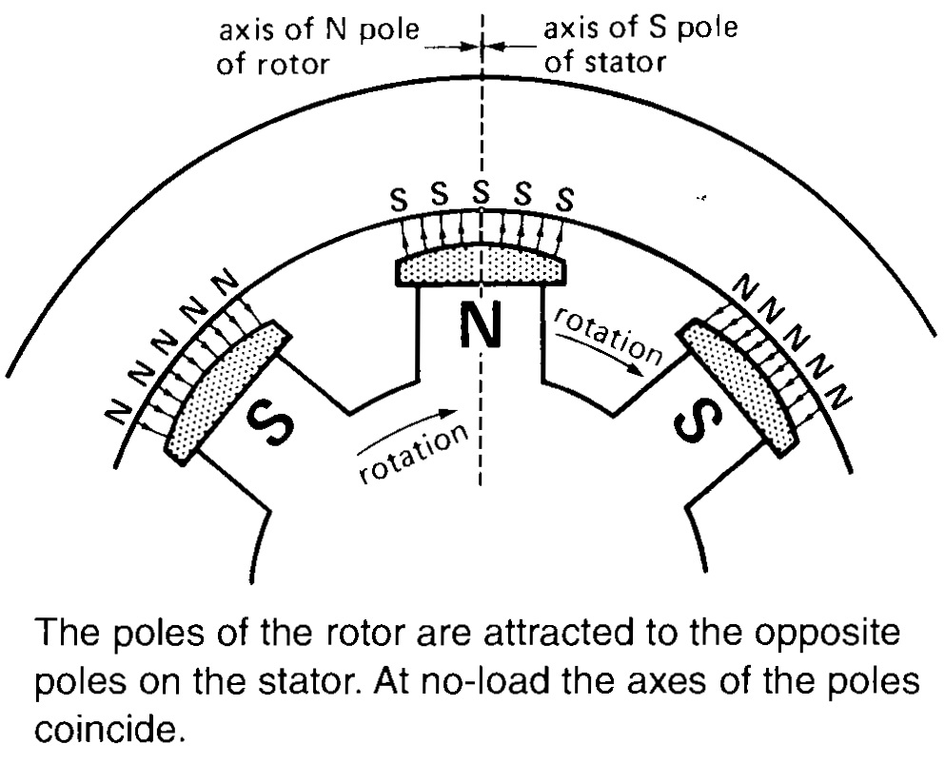
17.3 Pull-in Torque

Slide 9
17.4 Motor under load-general description
At no-load: Rotor poles are directly to stator poles and their axes coincide (figure on previous slide)
At mechanical load: Rotor poles slightly lags behind the stator poles but rotor continues to turn at synchronous speed
Mechanical angle α increases with increasing load
In spite of rotor lagging, magnetic attraction keeps the rotor locked to revolving field, and the motor develops an even more powerful torque as the mechanical angel increases
Limit: Exceeding of mechanical loading than that of pull-out torque will bring motor to halt condition
Motor gets out of step and creates disturbance on line and causes circuit breakers to trip => Saves motor as squirrel-cage and stator get overheated if motor fails to rotate at synchronous speed
Pull-out torque depends upon the mmf developed by stator and rotor poles
Rotor mmf depends upon the DC excitation I_{X} while stator mmf depends upon AC flowing into the windings
Mechanical angle α has direct impact on stator current => Current increases with increasing α
Larger angle => Bigger mechanical load => Increased current or power (supplied by 3-phase power supply)

Slide 10
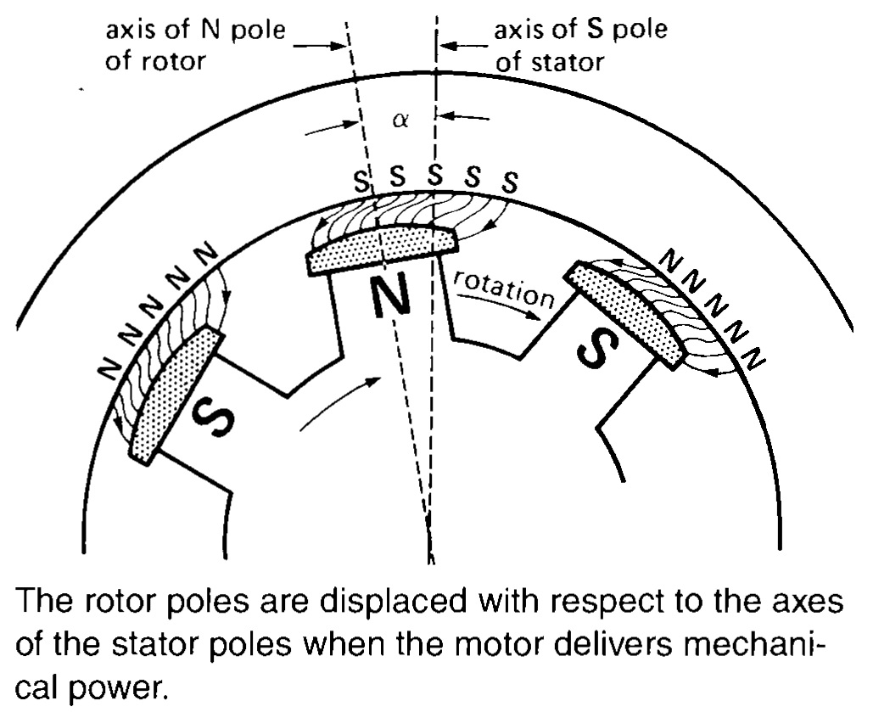
17.4 Motor under load-general description

Slide 11
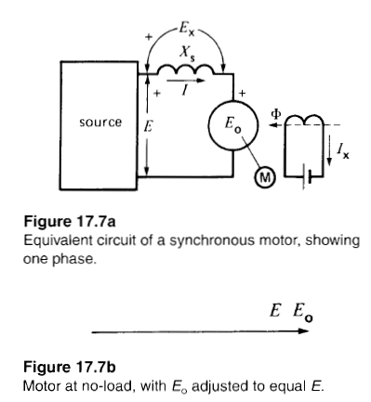
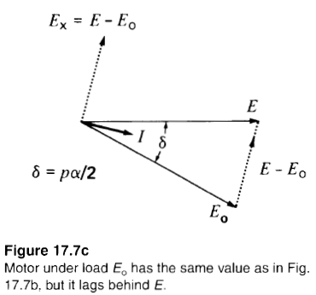
17.5 Motor under load Simple Calculations

Slide 12
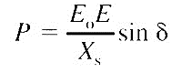
17.6 Power and Torque
At loading, synchronous motor draws active power from line, power is given by the following equation:
Active power depends upon Supply voltage E , Excitation voltage E_{o} and phase angle ϭ between E and E_{o}
Mechanical power developed by synchronous motor is given by following equation:
Mechanical power increases with torque angle and is maximum when ϭ = 90°
The peak power P_{max} is given by:
Torque is directly proportional to mechanical power and is given by:
Maximum torque developed by motor is called pull-out torque
Maximum torque occurs at ϭ = 90°

Slide 13
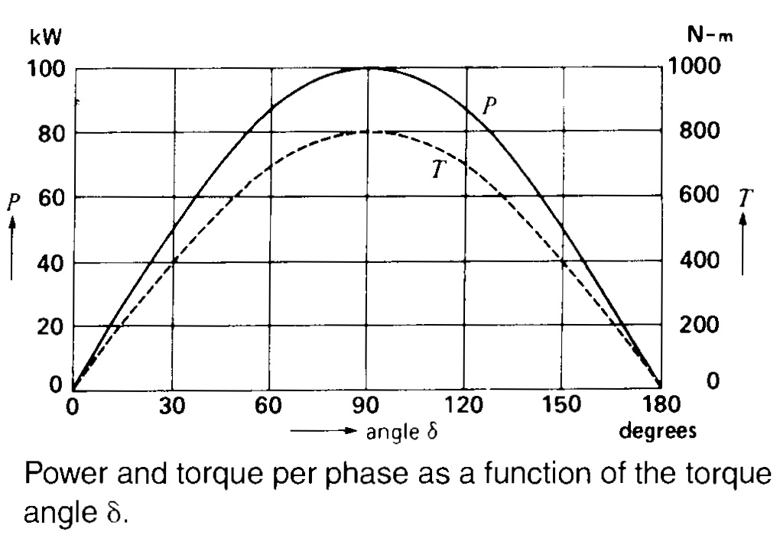
17.6 Power and Torque

Slide 14
17.7 Mechanical and Electrical angle
Relationship between mechanical angle, torque angle and number of poles is given by:

Slide 15
17.8 Reluctance torque
At no load motor will continues to run at synchronous speed even if we reduce the excitation current to zero
Reason: Flux produced by stator prefers to cross the short air gap between salient poles rather than that of much longer air gap between the poles. In other words, reluctance of magnetic circuit is less in the axis of salient poles, flux is concentrated as shown in figure. On account of this phenomenon, the motor develops a reluctance torque
Rotor will lag behind the stator after application of mechanical load, new magnetic flux shape is shown in figure:
So, considerable amount of reluctance torque can be developed without DC excitation
Reluctance torque becomes zero when rotor poles are midway between the stator poles because stator poles attracts salient poles in opposite direction
Reluctance torque is zero at the angle where regular torque is maximum. i.e. ϭ = 90°

Slide 16
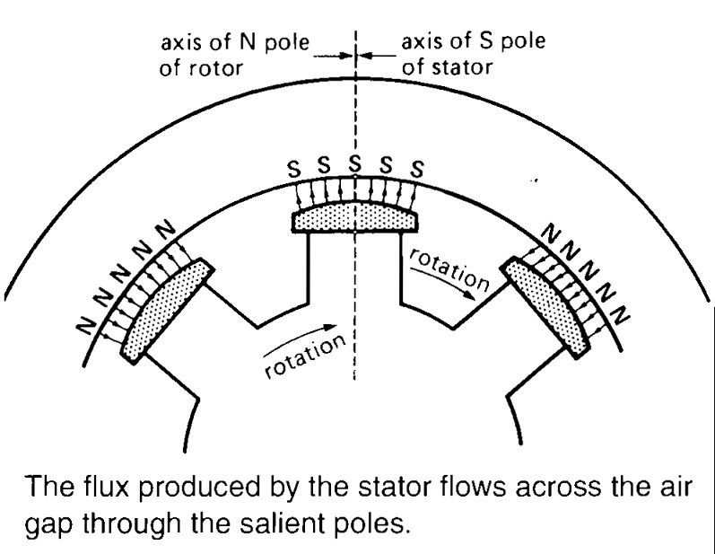
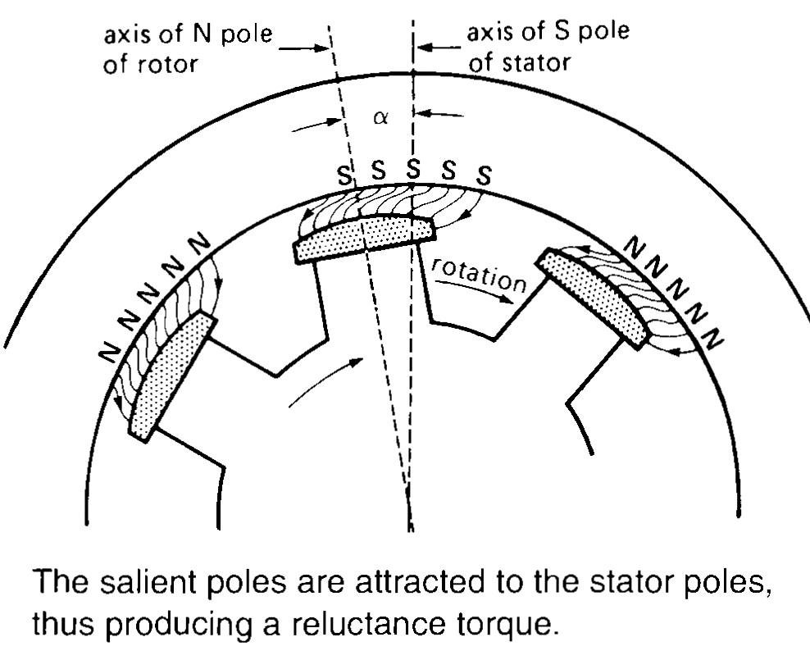
17.8 Reluctance torque

Slide 17
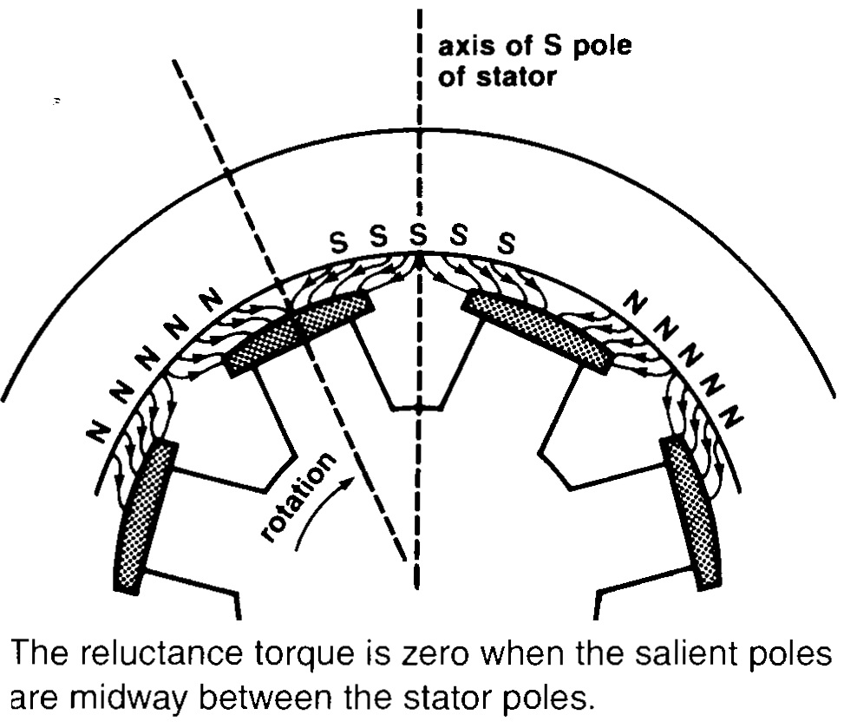
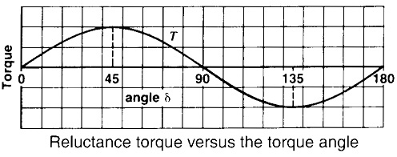
17.8 Reluctance torque
Unstable Region

Slide 18
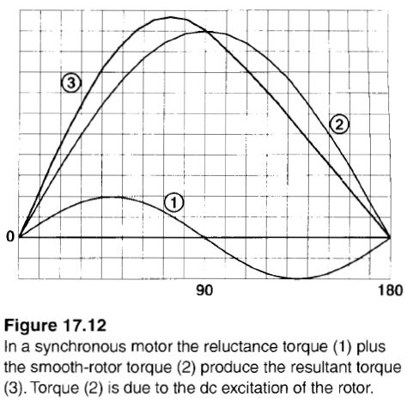
17.8 Reluctance torque

Slide 19
17.10 Excitation and reactive power
Wye-connected synchronous motor connected to 3-phase source with fixed line voltage E_{L} and also fixed line to neutral voltage E
Line current I produces mmf U_{a} in stator and rotor produces DC mmf U_{r} => Total flux ɸ is created by the combination of U_{a} and U_{r}
Above combined flux of rotor and stator induces line-to-neutral voltage in E_{a} stator. By neglecting IR losses we can say E_{a} = E => Flux ɸ is fixed as E is fixed
mmf needed to create the constant flux ɸ may be produced by stator or rotor or by both. If:
Rotor current I_{x}=0 => All the flux has to be produced by stator
If Rotor current I_{x} have some value then less reactive power will be absorbed from line by stator
If rotor produces all the flux needed then no reactive power will be drawn from line by stator
If rotor produces more flux than that of required then rotor will behave as a source of reactive power
In this way power factor of machine is improved
Synchronous motors some time used in industry to correct the power factor of plant along with furnishing mechanical power to the load they are driving

Slide 20
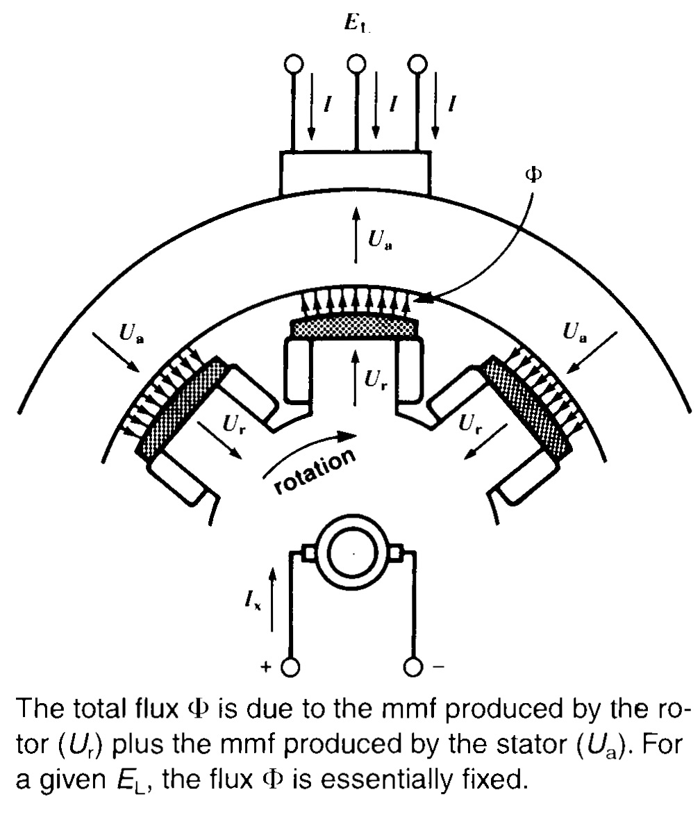
17.10 Excitation and Reactive Power

Slide 21

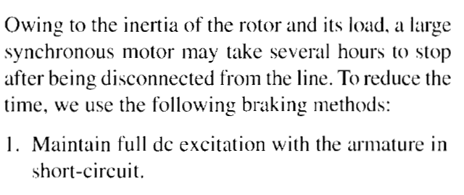
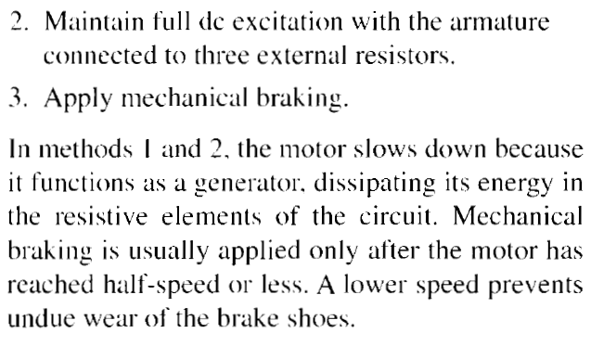
17.13 Stopping Synchronous Motors

Slide 22
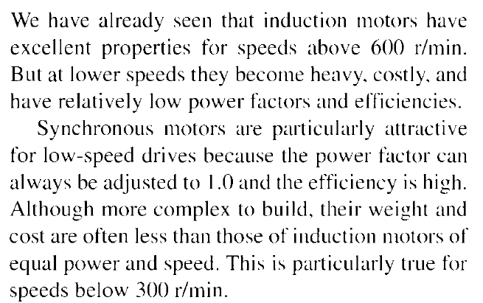
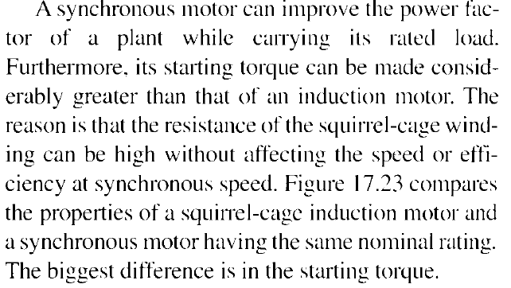
17.14 Synchronous Motors vs Induction Motors

Slide 23
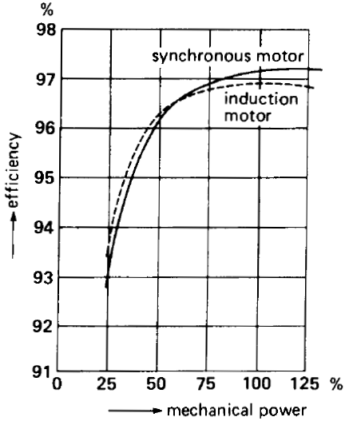
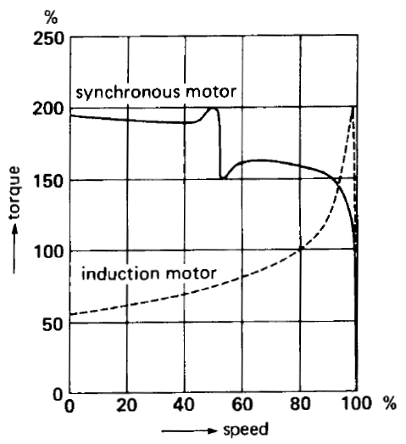
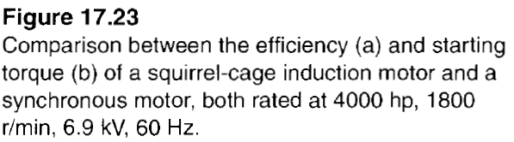
17.14 Synchronous Motors vs Induction Motors

Slide 24
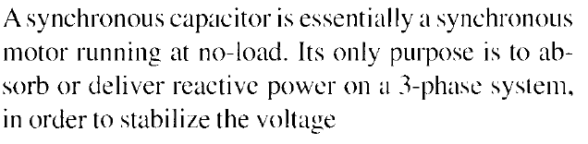
17.15 Synchronous Capacitor

Slide 25
Summary
Topics: 17.1-17.8,17.10, 17.13-17.15
Examples: 17.1-17.4
Assignment: 17.1-17.4, Deadline 12 December 2017

